Slide 1



AI ASSISTED CODING
Exploring Cutting-Edge Technology Shaping The Future

Slide 2


PROJECT TITLE
CROP YIELD PREDICTION

Slide 3

TEAM DETAILS
1.
DONI SIRI-2403A51075
U.YOGESHWAR-2403A51076
2.
3.
J.VAMSHI KRISHNA-2403A51074

Slide 4




OBJECTIVES
To analyze soil, weather, and rainfall parameters.
To build a predictive model for estimating crop yield. To support farmers in selecting suitable crops.
To implement a user-friendly web application for predictions.
To increase crop productivity using data-driven insights.

Slide 5
STAKEHOLDERS
Farmers – Use predictions for crop selection.
Agricultural Researchers – Study patterns and develop better crop strategies.
Government Agencies – Use insights for agricultural planning. Developers – Maintain and update the application.
Agri-Markets/Traders – Predict market demand and supply.

Slide 6

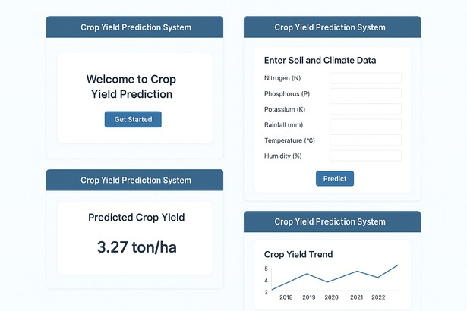
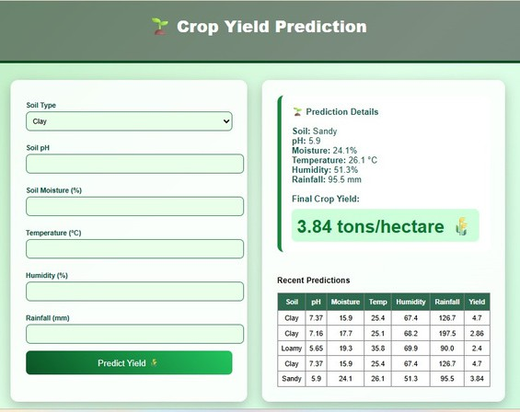
PROGRAMMING LANGUAGES, TOOLS, AND SOFTWARE
Python,HTML, CSS
Python Backend logic
Flask Web framework for UI and routing
HTML + CSS Frontend interface
Pandas Dataset filtering CSV Data storage
1.
2.
3.
VS CODE
FRONT-END VIEW OF WEB/MOBILE APPLICATION

Slide 7




SOFTWARE APPLICATION,CODE,AI TOOLS
A SYSTEM THAT PREDICTS CROP YIELD USING SOIL, WEATHER, AND RAINFALL DATA WITH MACHINE LEARNING.
FEATURES:
Soil and weather input AI-based yield prediction Charts and comparisons Simple web interface PDF output
MODULES:
Data collection Data cleaning ML model
Web app
Database USE CASES:
Farmers choose best crop
Government planning Research studies Student learning
# READING INPUT VALUES FROM THE FORM SOIL = REQUEST.FORM['SOIL_TYPE']
PH = FLOAT(REQUEST.FORM['PH']) MOISTURE = FLOAT(REQUEST.FORM['MOISTURE']) TEMP = FLOAT(REQUEST.FORM['TEMPERATURE']) HUMIDITY = FLOAT(REQUEST.FORM['HUMIDITY'])
RAINFALL = FLOAT(REQUEST.FORM['RAINFALL']) # MATCHING INPUT WITH DATASET TO FIND EXACT YIELD
MATCHED = DF[ (DF["SOIL_TYPE"] == SOIL) &
(DF["SOIL_PH"] == PH) & (DF["SOIL_MOISTURE"] == MOISTURE) & (DF["TEMPERATURE"] == TEMP) & (DF["HUMIDITY"] == HUMIDITY) & (DF["RAINFALL"] == RAINFALL)
]
# IF MATCH FOUND → SHOW PREDICTED YIELD IF NOT MATCHED.EMPTY:
RESULT = ROUND(MATCHED["CROP_YIELD"].VALUES[0], 3)
ELSE:
RESULT = "NO EXACT MATCH FOUND"
1.
2.
3.
GitHub Copilot:
Assisted in auto completing Python & Flask code.
Google Gemini:
Used for data cleaning ideas & model
tuning.
Canva:
Used to design PPT slides professionally.

Slide 8
THANK
YOU!

